Slide 1






Welcome to Our Virtual and Online Course Support Workshop
Settle in – we’ll get started soon.
Make sure you’re using Chrome or Firefox .
Please turn off your video and microphone to minimize connection and feedback issues.
If you have questions throughout the session, add them to the chat:
  Open the panel by clicking on the purple tab in the lower-right corner.
  You can also access video/audio settings by clicking on the gear icon in this panel.
If you wish to ask vocally, click the raise your hand icon:
  When ready, the moderator will prompt you to turn on your microphone.
If at any point during the session you experience connection issues, try leaving and coming back in.
Note: This session will be recorded and shared with you and publicly on the DMACC website.

Slide 2
Your Hosts
Amanda Rodenborn: Blackboard Collaborate Ultra, Technology Tips, and General Blackboard Course/Platform Navigation
Farfum Ladroma: Online Academic Achievement Center and Testing Information
Mary McClure: Online Counseling, Self-Help Strategies, Health, and Community Resources Information
Kris Olds, Abbie Finnegan and Holly Hedberg: Registration and Online Advising Resources

Slide 3
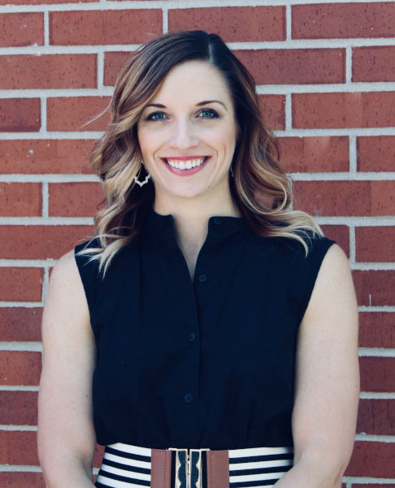



Distance Learning (Online Department)
Host: Amanda Rodenborn, Instructional Designer and Professor
What We Do: Support and train faculty and students on best practices for the web, Blackboard, teaching, and learning
DMACC Course Types before and after COVID-19
  Web-enhanced (face-to-face/traditional) → Real-time virtual
  Web-blended (face-to-face and online) → Web-blended (virtual and online)
  Online
Get Help
  Email Your Instructor: DMACC Phone Directory
  Contact DMACC Tech Support
Blackboard Collaborate
Blackboard Basics for Students Course

Slide 4
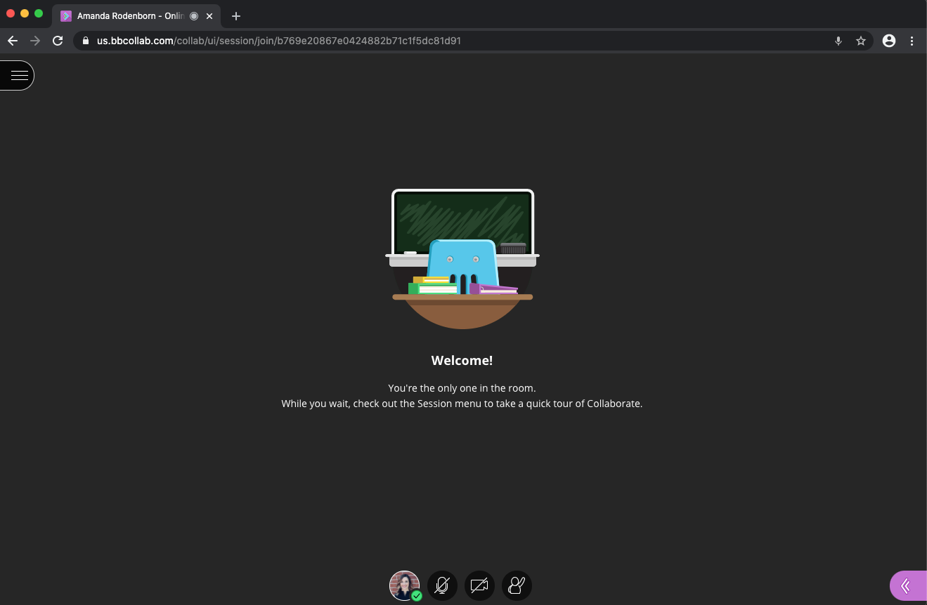
Blackboard Collaborate: Joining

Slide 5
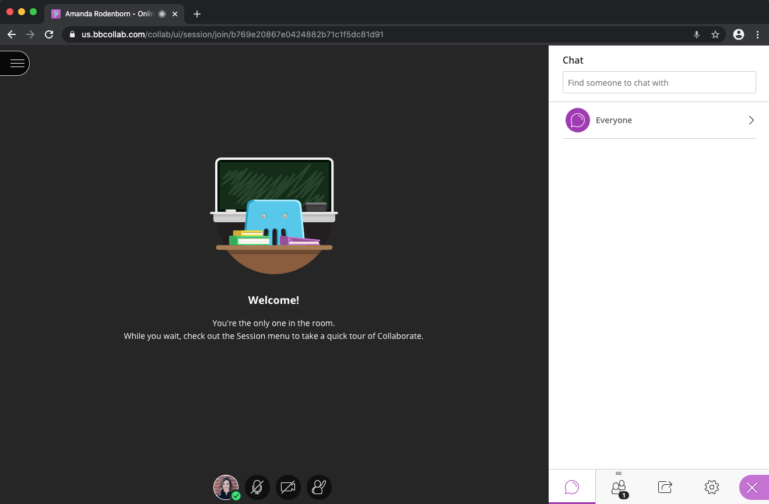
Blackboard Collaborate: Features
Tips
Dress and behave like you’re in class—because you are. ☺
Beware of distracting surroundings, movement, and noise

Slide 6
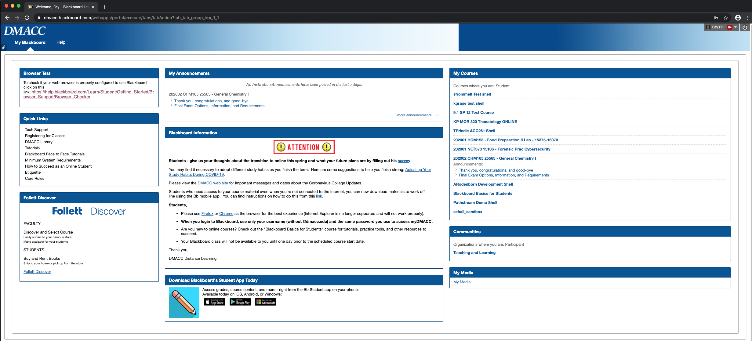
Blackboard Site
Enter through myDMACC portal or dmacc.blackboard.com (same sign-on as myDMACC)

Slide 7
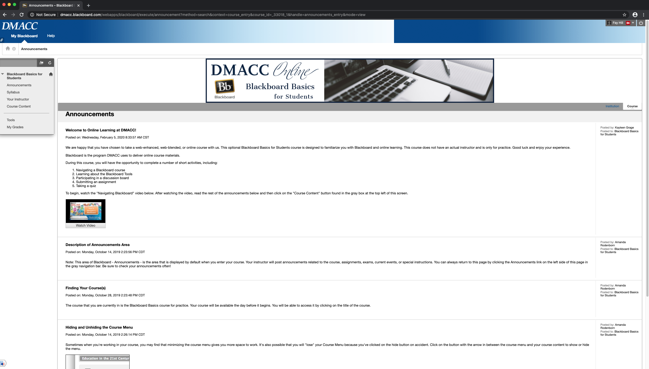
Blackboard Basics for Students Course

Slide 8
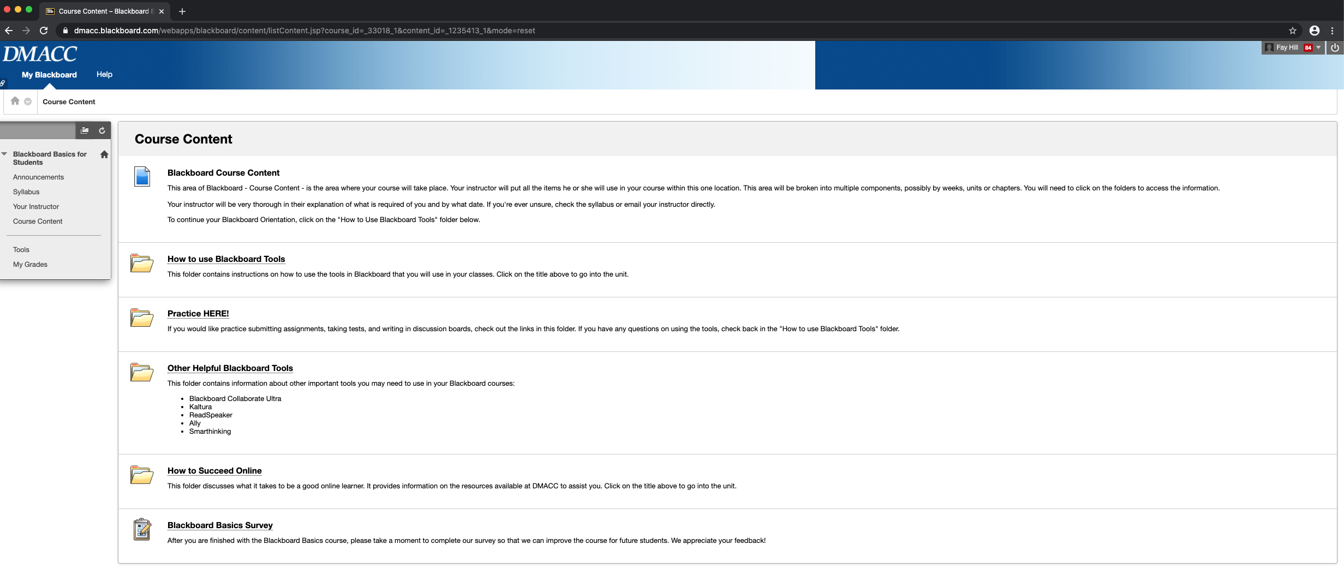
Bb Basics for Students: Course Content

Slide 9


Academic Support Services: Testing
Host: Farfum Ladroma, Urban Campus Testing Center and AAC Coordinator
Due to the current closure of all DMACC locations to the public, we are implementing remote ACCUPLACER and TEAS testing to help you complete your DMACC pre-admission requirements in a timely manner.
ACCUPLACER Remote Testing (Reading/Writing and ELL Placement)
  To test remotely, students MUST have access to a computer (desktop or laptop) with a webcam and audio capabilities. (No cost)
  Remote testing may NOT be completed through a smartphone.
TEAS Remote Testing (Nursing and Surgical Tech Assessment)
  To test remotely, students MUST have a desktop or laptop computer with a microphone and webcam, as well as Google Chrome installed. (Extra $5 fee by Proctorio)
  Remote testing may NOT be completed through a smartphone.
TO SIGN UP FOR TESTING: Go to the DMACC Testing Center website.
If you have any questions, please contact RemoteTesting@dmacc.edu.

Slide 10
Testing Continued…
Make-Up Exams
  Student to consult with faculty member for all make up exams
  Faculty: May use Blackboard exams, Respondus LockDown Browser, Respondus Monitor, or ProctorU
Disability Services and Students with Accommodations
  Consult with Disability Services (dso@dmacc.edu) or Campus Liaisons for students requesting a scribe, extended time, or other accommodations.
Most other exams are temporarily suspended at this time.
  If program departments have additional requests for remote testing, please contact RemoteTesting@dmacc.edu.
ALEKS Workshops will be available remotely starting the week of May 18. More details to follow.

Slide 11

District-Wide Tutoring: DOT
DMACC Online Tutoring (DOT)—Work with faculty through Blackboard Collaborate
  Use Google Chrome when entering a session.
  Labs covered: Math, Science, Social Science, Writing, Library/Research, Accounting, Computer, and Engineering/C++ Program Languages
  Hours: day, evening, and weekends.
  Closed on Thursday, May 7 at 1:30 pm and reopens Tuesday, May 26.
  If you have more questions, please contact uctestingcenter@dmacc.edu

Slide 12
District-Wide Tutoring: DTE
DMACC Tutoring through Email (DTE)—Work with faculty to answer questions through email.
  For detailed hours and availability, please go to the Ankeny Academic Achievement Center webpage.
  Chemistry and Physics: aacchemistryphysics@dmacc.edu
  Accounting: aacaccounting@dmacc.edu
  Math: aacmath@dmacc.edu
  Writing Lab: aacwritinglab@dmacc.edu
  Biology: aacbiology@dmacc.edu
  Spanish: svordonezjones@dmacc.edu
  SDV 108: krbaskerville@dmacc.edu
If you have questions about DTE or subject areas NOT covered, please contact Sharon Bittner at sgbittner@dmacc.edu

Slide 13
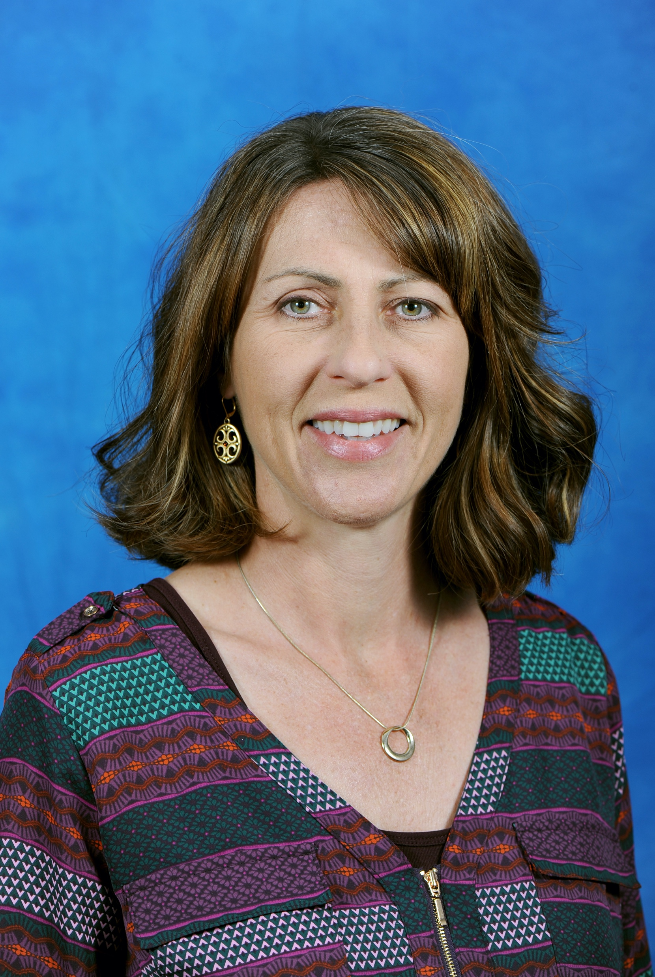
DMACC Counseling (Student Services)
Host: Mary McClure, Ankeny Campus Counselor and Faculty member
What We Do: Provide mental health and personal counseling services to all current students free of charge.
Sessions are available via Zoom or phone call.
Check out the Counseling Staff page (easily found in the A-Z index) to find a listing of counselors available on your campus.
DMACC also provides free telehealth sessions through the Student Assistance Program at Compass Counseling.
Mental Health virtual seminars are being held during the last few weeks of the semester. Check the DMACC Daily, your email, and DMACC social media for details.

Slide 14







DMACC Counseling Continued…
Self-Help Strategies
  Stay active – get outside!
  Stay busy – do at least one productive activity per day
  Stay connected – reach out to at least one person each day
  Set a schedule
Wellness Apps
  * denotes FREE
Headspace |  | Calm |  | Happify
MindShift* |  | MoodKit |  | Breathe 2 Relax*
 |  | Anxiety Coach

Slide 15
Other Campus Health Services
Community Resource information is available on the DMACC Counseling webpage.
Campus Health is still available to students!
  Zoom meetings with the Campus Health Specialist or the Nurse Practitioner can be scheduled.
  Nurse Practitioner hours: Tuesdays, 8:00 AM-4:00 PM and Wednesdays, 8:00 AM- 12:00 PM
  Students must contact Campus Health to set up a meeting time and provide contact and meeting information.
Contact Campus Health: Call 515-964-6352 and leave a message (checked regularly) or email Sandra Foster at safoster2@dmacc.edu​

Slide 16
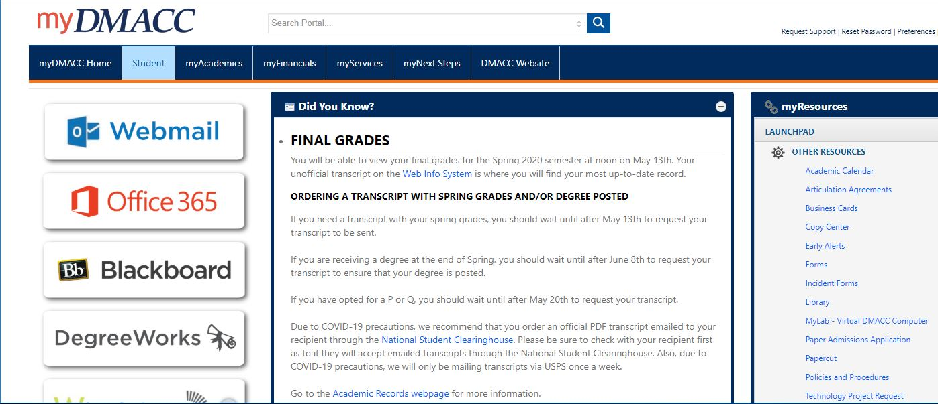
Registering for Classes, step 1

Slide 17
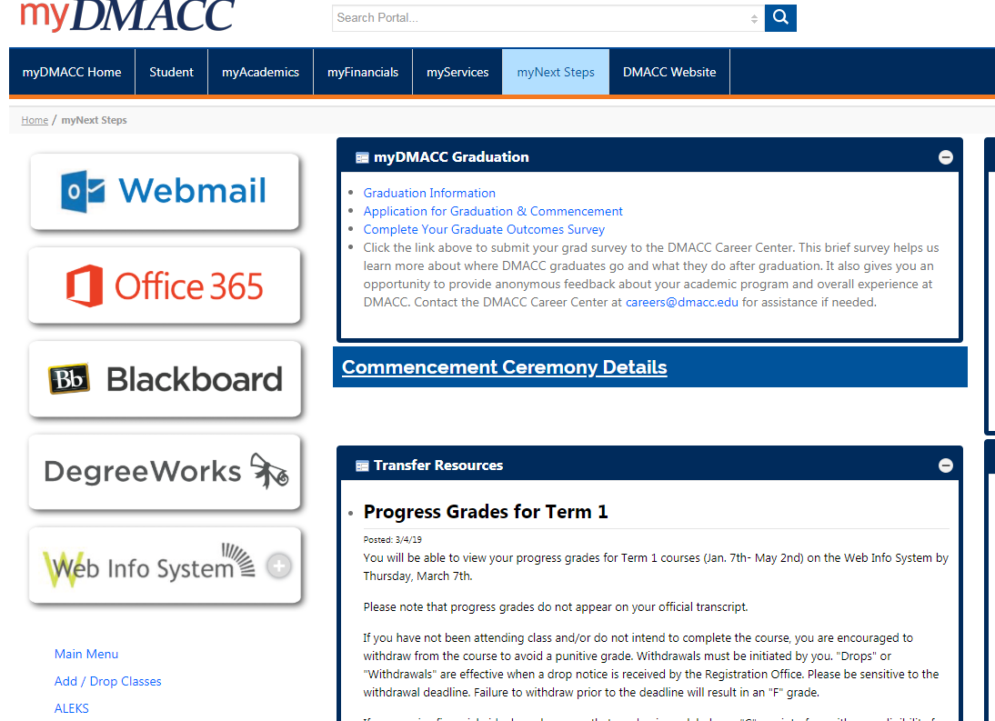
Registering for Classes, step 2

Slide 18
Registering for Classes, step 3

Slide 19
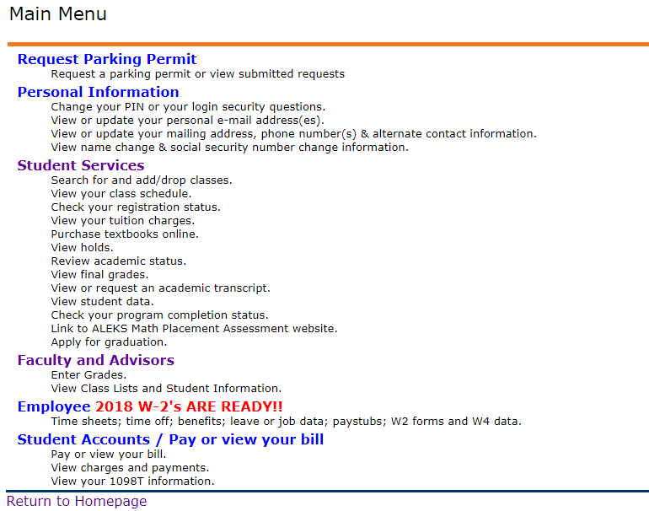
Registering for Classes, step 4

Slide 20
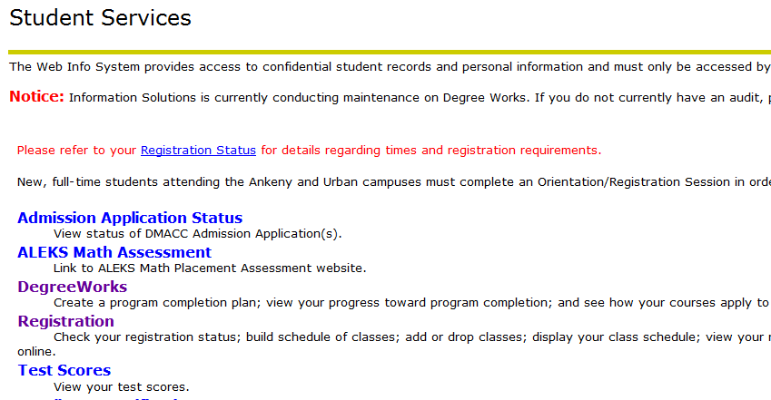
Registering for Classes, step 5

Slide 21
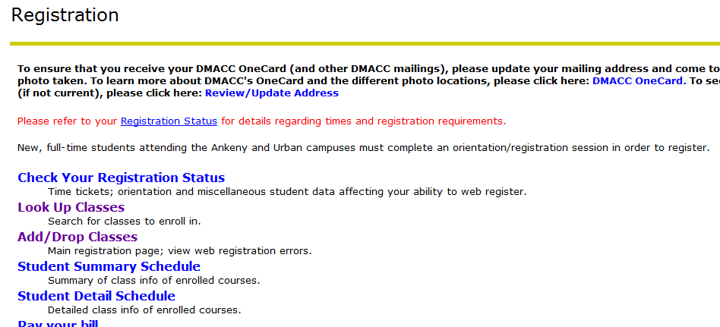
Registering for Classes, step 6

Slide 22
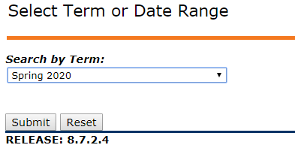
Registering for Classes, step 7

Slide 23
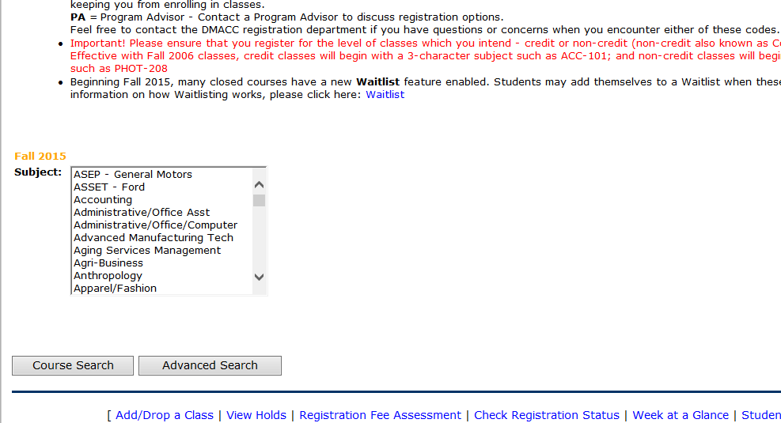
Registering for Classes, step 8

Slide 24
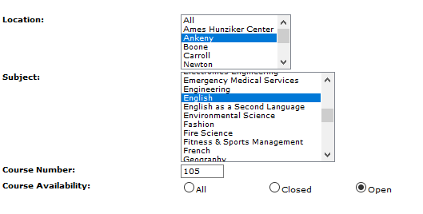
Registering for Classes, step 9

Slide 25
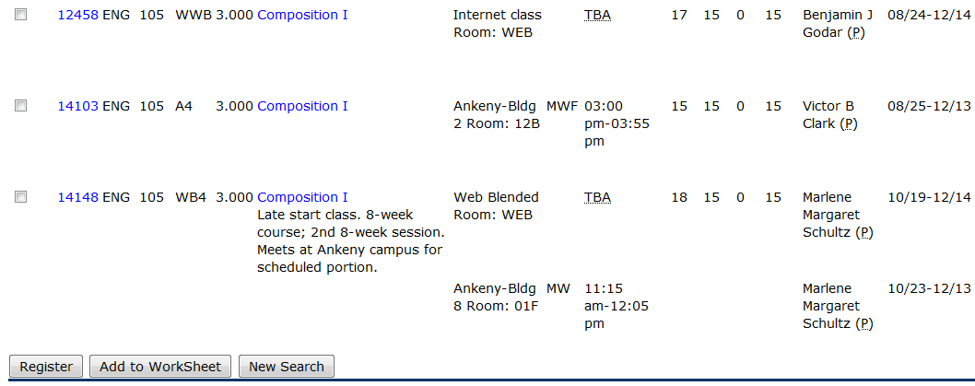
Registering for Classes, step 10

Slide 26
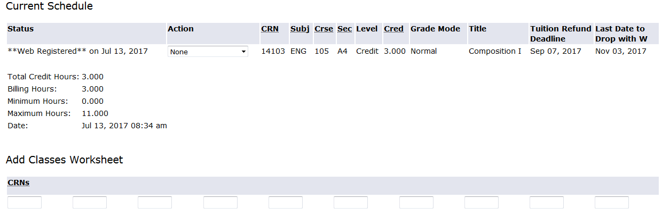
Registering for Classes, step 11

Slide 27
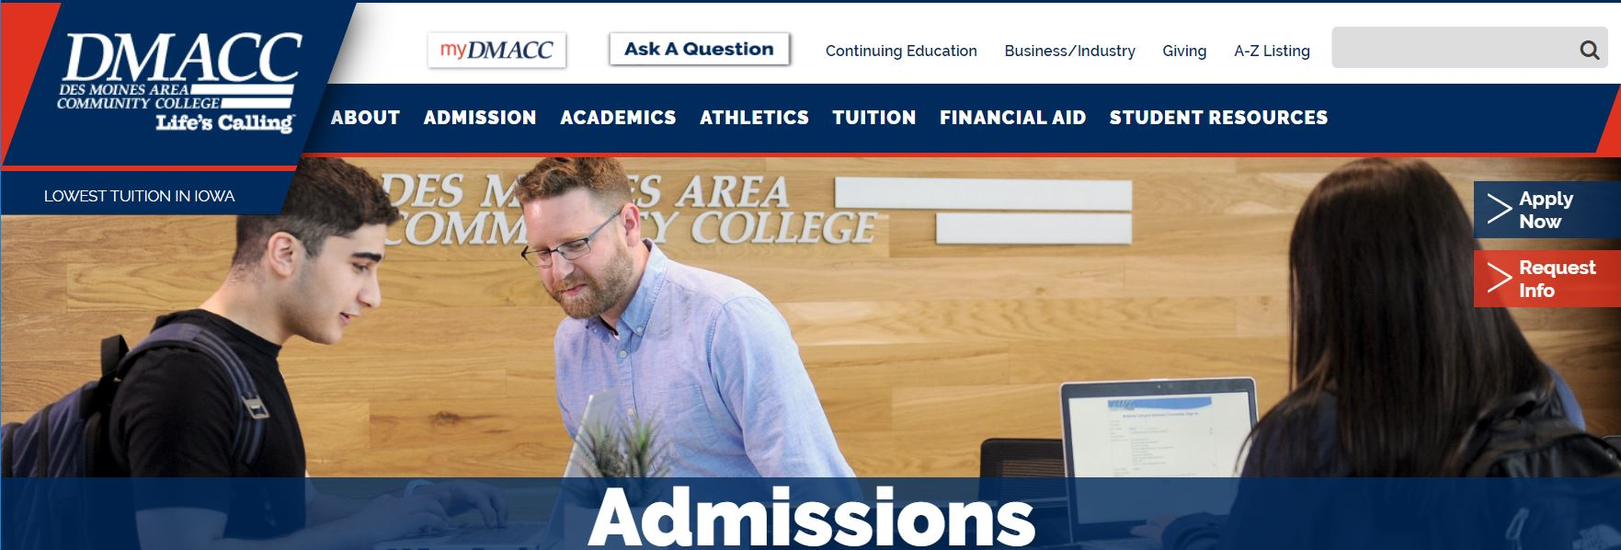
Finding Your Advisor, step 1

Slide 28
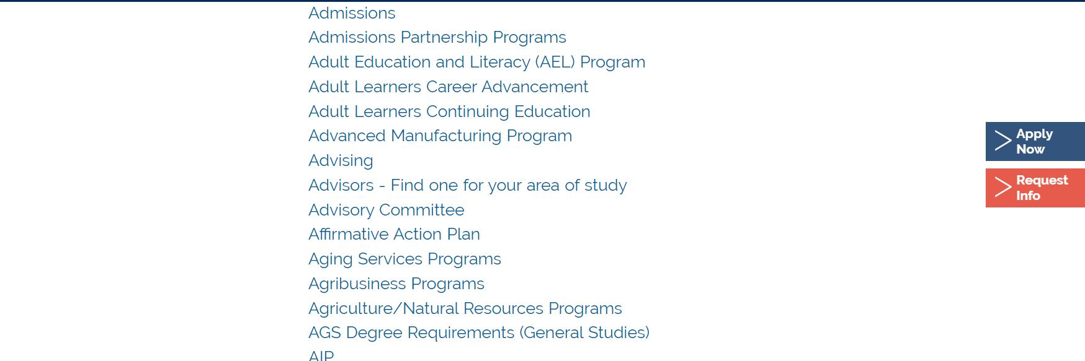
Finding Your Advisor, step 2

Slide 29
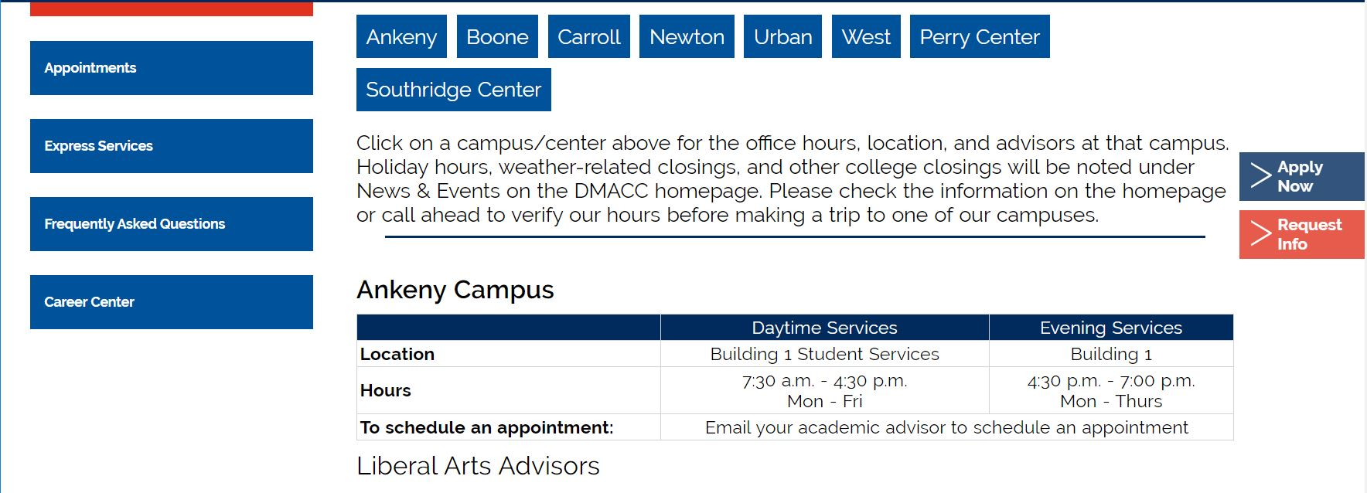
Finding Your Advisor, step 3

Slide 30
Q & A and Contact Information
What questions do you have?
Amanda Rodenborn, Instructional Designer, ajrodenborn@dmacc.edu
Farfum Ladroma, Testing Center and AAC Coordinator, ffladroma@dmacc.edu
Mary McClure, Counselor, mmmcclure@dmacc.edu
Kris Olds, Academic Advisor, klolds@dmacc.edu
Holly Hedberg, Academic Advisor, hmhedberg@dmacc.edu
Abbie Finnegan, Academic Advisor, ajfinnegan1@dmacc.edu

